Slide 1
NAME-338 Ship Design Project & Presentation
Supervised by,
Dr. N. M. Golam Zakaria
Professor,
Dept. of NAME,
BUET.
Presented by,
Touseef Hasan
Student ID: 1812044,
Mehedi Hasan
Student ID: 1712046.

Slide 2
Contents
Principal Particulars
Lightweight, Deadweight and Displacement Calculation
General Arrangement
Lines Plan
Hydrostatic Calculation
Scantling
Detailed Lightweight and Deadweight Calculation
Approximate Trim and Stability Calculation
Resistance and Power Calculation
Rudder Design & Steering Arrangement
Propeller Design
Engine Selection & Design of Engine Foundation

Slide 3
Owner’s Requirements
Vessel Type: Bulk Carrier
Capacity: 2300 tonnes
Service Speed: 10 knots
Route: Dhaka – Chittagong (Inland)
Route Distance: 315 km (171 nautical miles)

Slide 4
Principal Particulars of Basis Ship
Length Overall
Length between Perpendiculars
Breadth Mld.
Depth Mld.
Draft
Engine Power
Service Speed
CB
CD
: 63.2 m
: 61.5 m
: 10.2 m
: 4.6 m
: 3.5 m
: 522*2 KW
: 10 knots
: 0.79
: 0.76
Notes:
For our basis ship, we tried to look for vessels that are in service in this route. After consideration and following the suggestions of our supervisor, we selected a coal carrier having the following particulars.

Slide 5
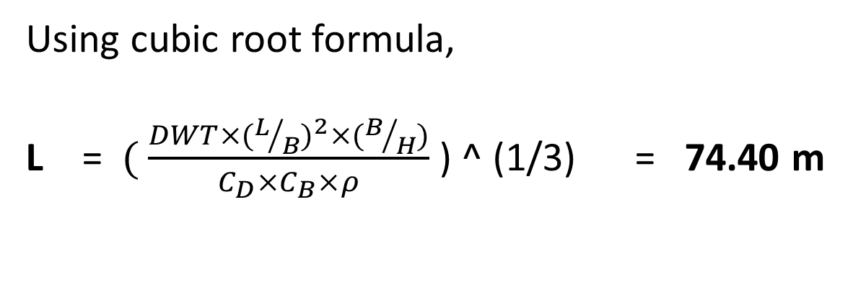
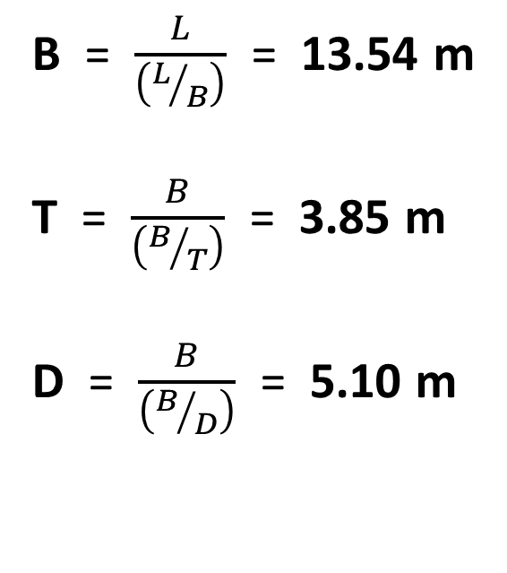
Determining Principal Particulars
Using cubic root formula,
L =$( \frac{DWT×{(L/B)}^{2}×(B/H)}{C_{D}×C_{B}×ρ}$ ) ^ (1/3) = 74.40 m
B = $\frac{L}{\left(L/B\right)}$ = 13.54 m
T = $\frac{B}{\left(B/T\right)}$ = 3.85 m
D = $\frac{B}{\left(B/D\right)}$ = 5.10 m
Notes:
Taking length to breadth, breadth to depth and depth to draft ratios from the selected basis ship, acquiring its admiralty coefficient, we have -

Slide 6
Final Principal Particulars
Length Overall
Length between Perpendiculars
Breadth Mld.
Depth Mld.
Draft
Service Speed
CB
Deadweight :
Displacement :
: 76.4 m
: 74.4 m
: 13.54 m
: 5.1 m
: 3.85 m
: 10 knots
: 0.79
2328 tonnes
3063 tonnes
Notes:
Subtracting the deadweight from displacement, we got our lightweight 735 tonnes.

Slide 7
Manning
Master | (Class 1) | 1
 | (Class 2) | 1
Sailor |  | 8
Driver | (Class 1) | 1
 | (Class 2) | 1
Geezer |  | 3
Total Crew: |  | 15
Notes:
We took reference from ISO 2001 to find our crew number, which is 15.

Slide 8
General Arrangement Drawing

Slide 9
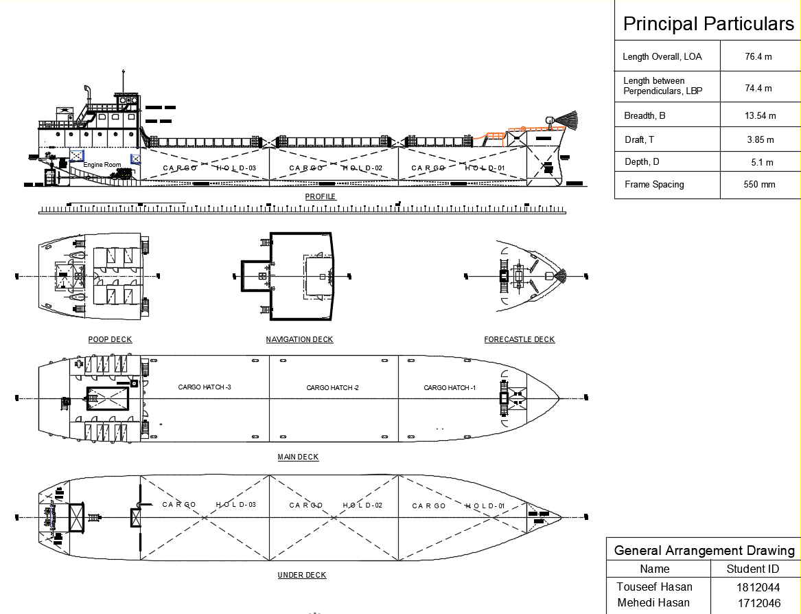

Slide 10
Lines Plan

Slide 11
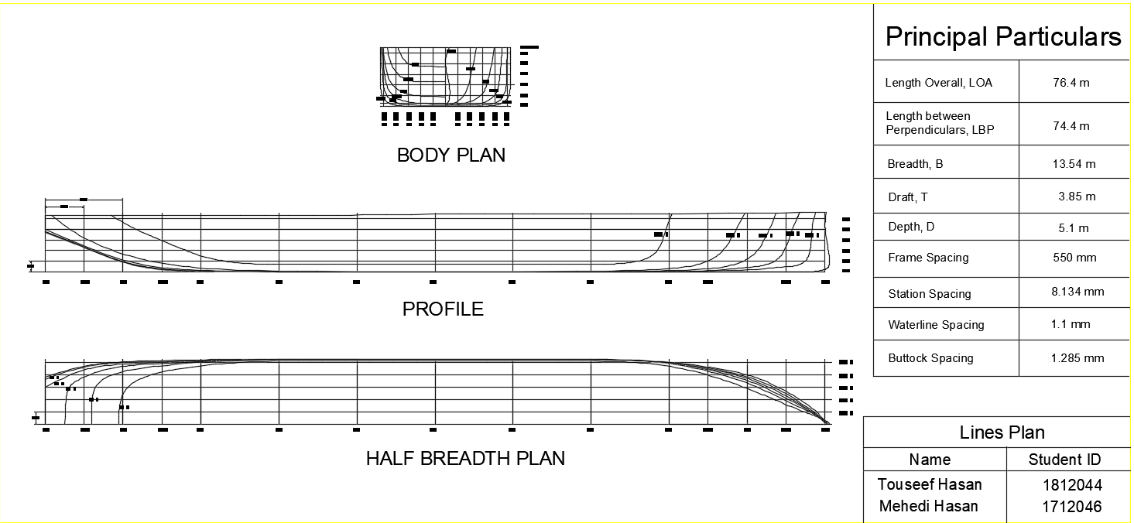

Slide 12
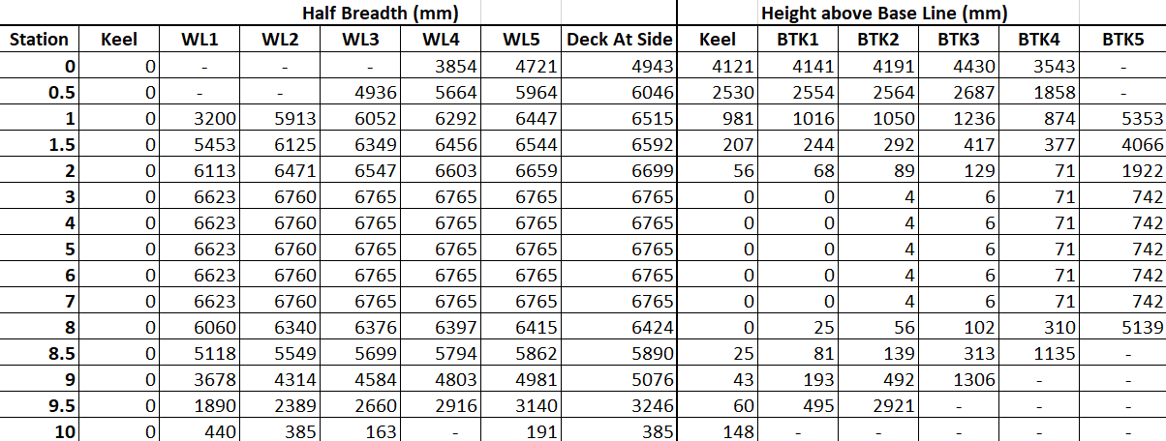
Offset Table

Slide 13
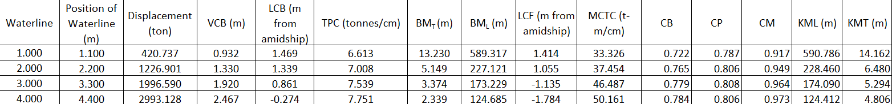
Summary of Hydrostatic Calculation

Slide 14
Hydrostatic Curves
VCB

Slide 15
Scantling Calculations
Reference Book Used: GL-2013
Summary: Thickness of Plates
Items | Dimension (Thickness)
Bottom Shell Plate | 11 mm
Bilge Plate | 10 mm
Side Shell Plate | 11 mm
Keel Plate | 13 mm
Deck Plate | 8 mm

Slide 16
Scantling Calculations (contd.)
Summary: Bottom Structure
Items | Dimension
Bottom Longitudinal | L-200x150x10
Bottom Center Girder | T-850x550x9
Bottom Side Girder | T-800x450x7
Inner Bottom Longitudinal | L-200x150x9
Floor | T-900x450x8

Slide 17
Scantling Calculations (contd.)
Summary: Side Structure
Items | Dimension
Main Frame | L-175x100x8
Web Frame | T-250x200x10
Side Longitudinal | L-150x75x8

Slide 18
Scantling Calculations (contd.)
Summary: Deck Structure
Items | Dimension
Deck Longitudinal | L-100x75x7
Deck Web | T-200x100x10

Slide 19
Scantling Calculations (contd.)
Summary: Watertight Bulkheads
Items | Dimension
Plate | t = 9 mm
Web | T-200x100x9
Vertical Stiffeners | L-75x50x9
Transverse Stiffeners | L-90x65x7

Slide 20
Scantling Calculations (contd.)
Summary: Superstructure
Items | Dimension
Top Plate | t = 7 mm
Side Plate | t = 9 mm
Side Frame | L-125x75x7
Web Frame | T-250x175x9
Deck Longitudinal | L-100x75x7

Slide 21
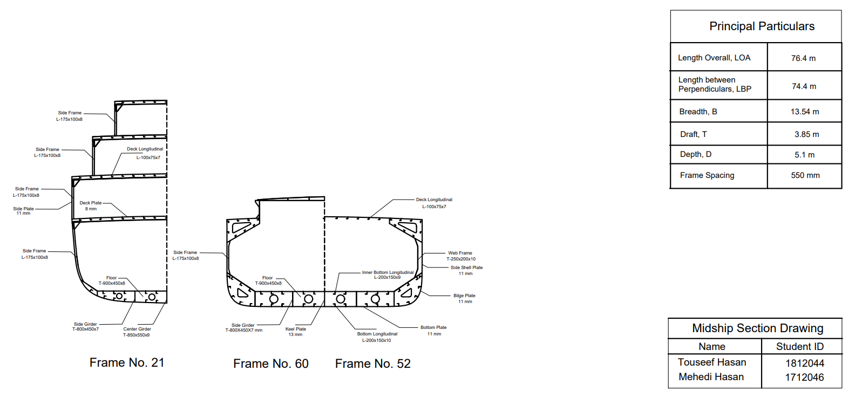
Midship Section Drawing

Slide 22
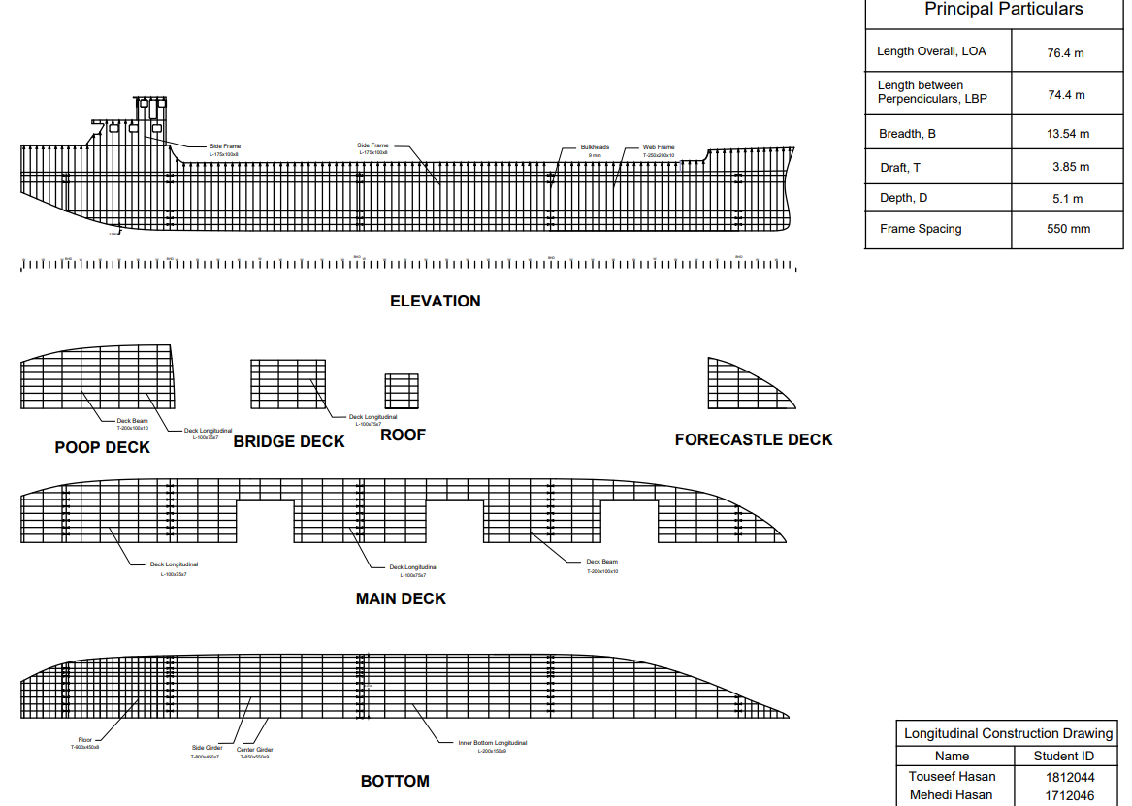
Longitudinal Construction Drawing

Slide 23
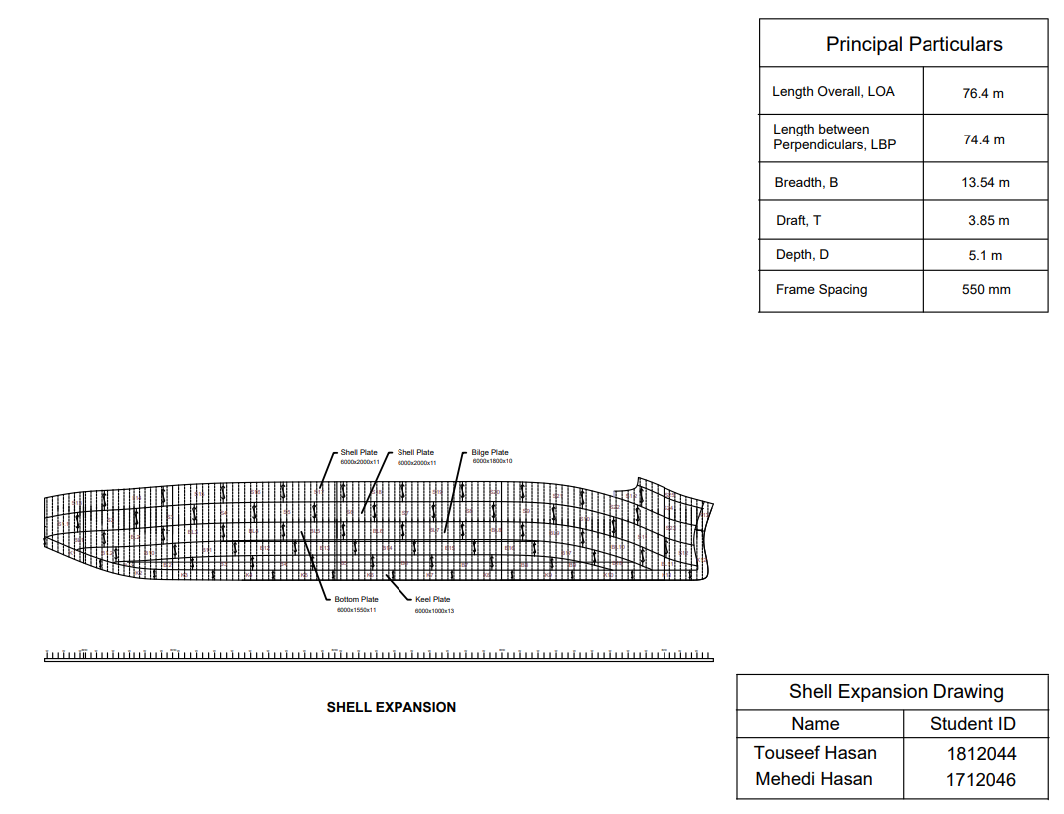
Shell Expansion Drawing

Slide 24
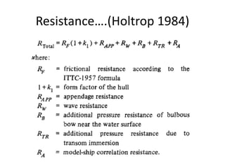
Resistance & Power Calculations
Holtrop & Mennen’s Method

Slide 25
Resistance & Power Calculations (contd.)
Resistance Summary
Frictional Resistance | R_{F} | 28.489 | kN
Resistance of Appendages | R_{APP} | 5.923 | kN
Wave Making and Wave Breaking Resistance | R_{W} | 15.896 | kN
Additional Resistance due to Bulbous Bow | R(B) | 0 | kN
Resistance of Immersed Transom Stern | R(TR) | 0.25 | kN
Model Ship Correlation Resistance | R_{A} | 8.428 | kN
Total Resistance | R_{T} | 58.381 | kN

Slide 26
Resistance & Power Calculations (contd.)
Power Summary
Effective Power | 300.312 | kW
ηo | 0.55
ηd (QPC) | 0.534
Delivered Power | 562.569 | kW
Shaft Power (considering shaft loss of 3.5%) | 582.974 | kW
Power (considering gear box loss of 5%) | 613.656 | kW
Power (considering sea margin of 15%) | 705.704 | kW
Total Brake Power (considering 85% MCR) | 830.241 | kW
Per Engine Brake Power | 415.121 | kW

Slide 27
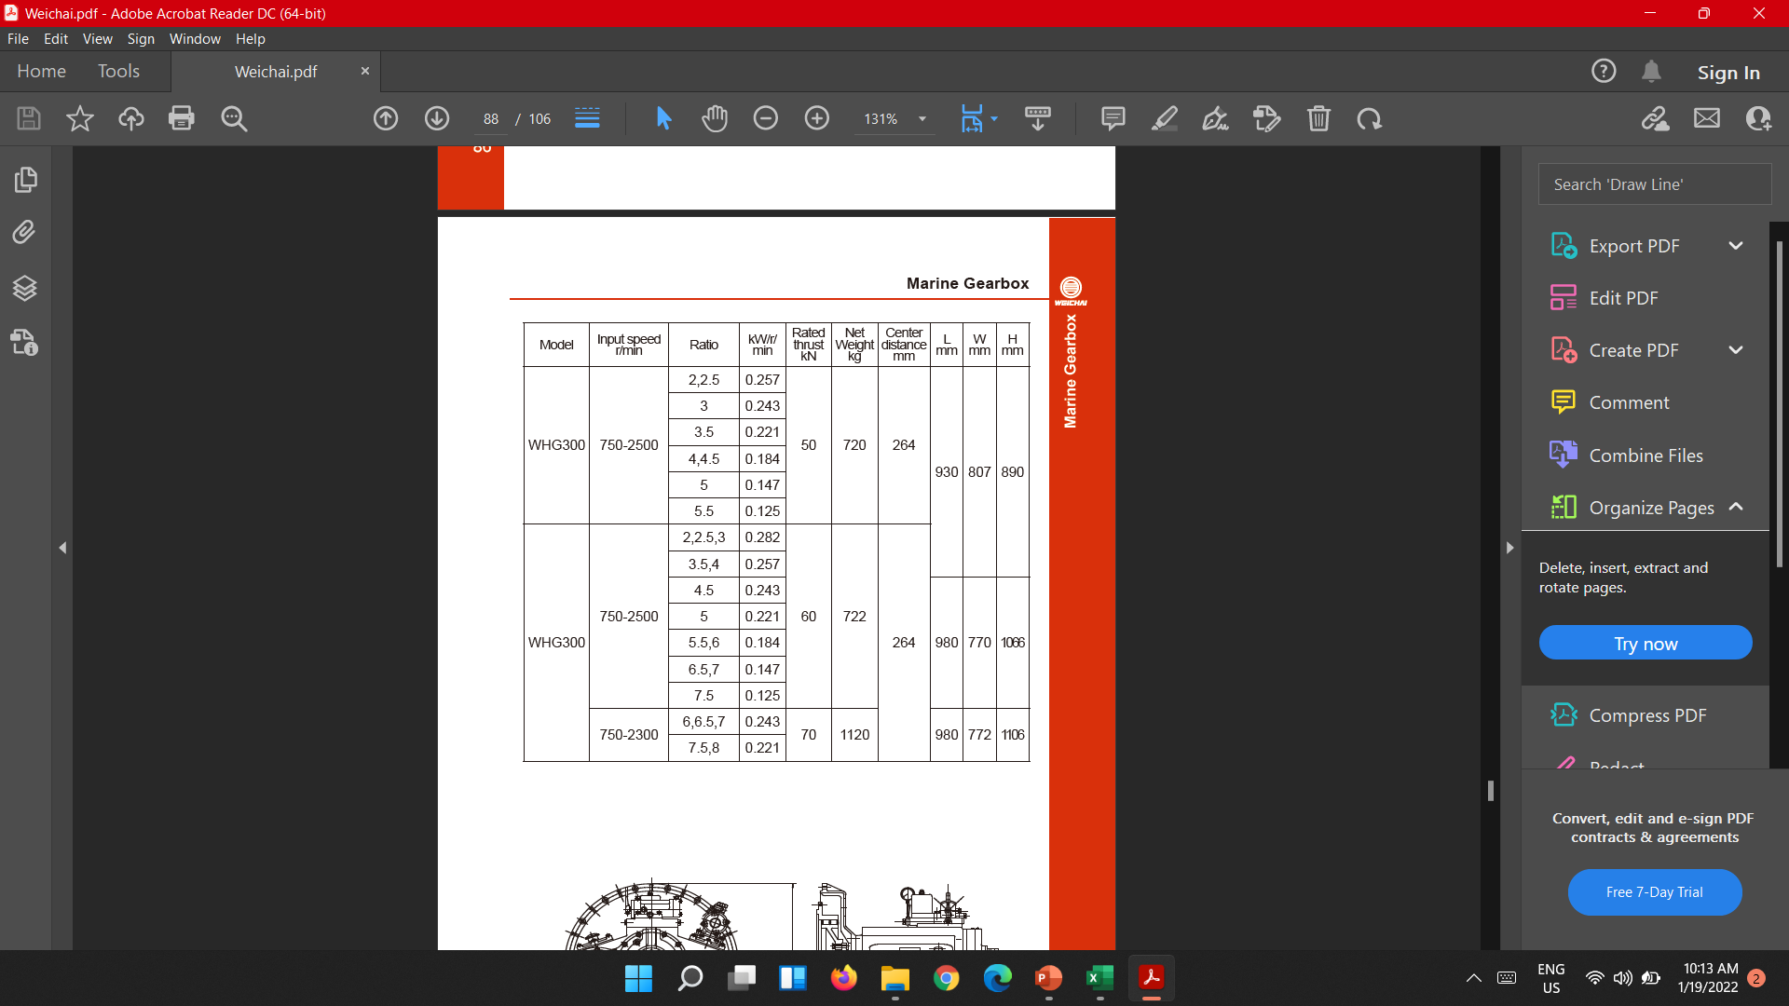
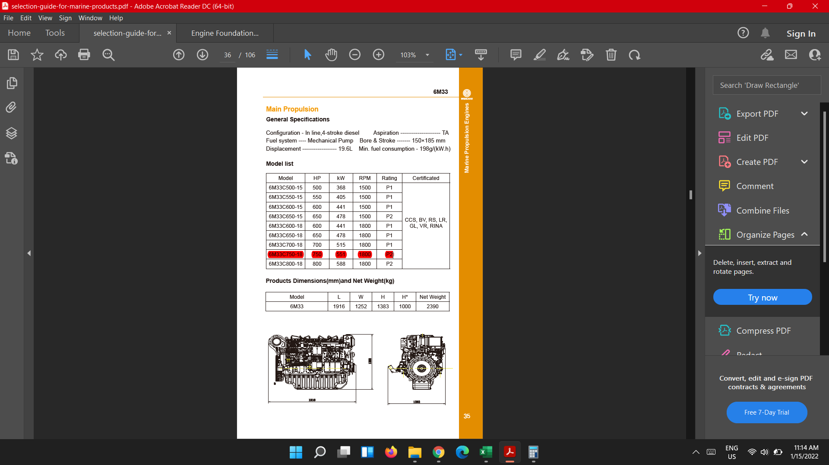
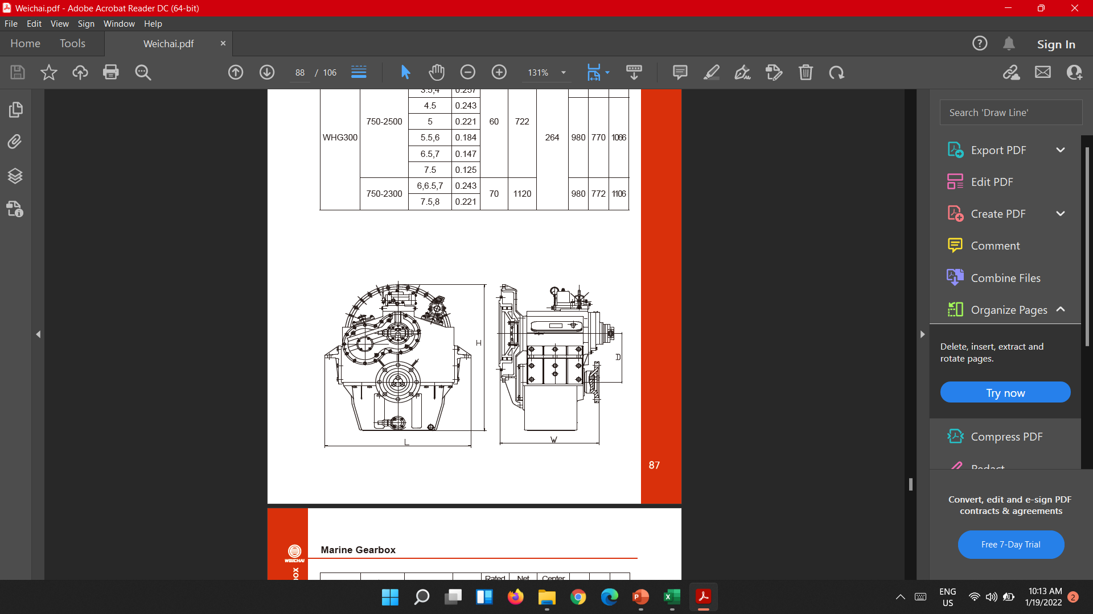
Engine Selection
Selection of Engine and Gear Box
Model | HP | KW | RPM | Rating | Certified By
6M33C750-18 | 649 | 484 | 1800 | P1 | CCS, BV, RS, LR, GL, VR, RINA

Slide 28
Rudder Design & Steering Arrangement
Scantling Summary (Rudder) (DNV – GL 2016)
Used Material | HLS GL F-40
Rudder Area (each) | 2.557 | m²
Mean height | 1.872 | m
Mean breadth | 1.366 | m
Aspect ratio | 1.371
Rudder Force | 41.71 | kN (ahead)
 | 10.92 | kN (astern)
Rudder Torque | 5.696 | kNm (ahead)
 | 6.115 | kNm (astern)
Rudder Stock Diameter | 70 | mm
Coupling Bolt Diameter | 20 | mm
Coupling Flange Thickness | 20 | mm
Rudder Plate Thickness | 8 | mm
Rudder Web Thickness | 7 | mm
Pintle Diameter | 84 | mm
Bearing liners | 8 | mm
NACA Section | 0010

Slide 29
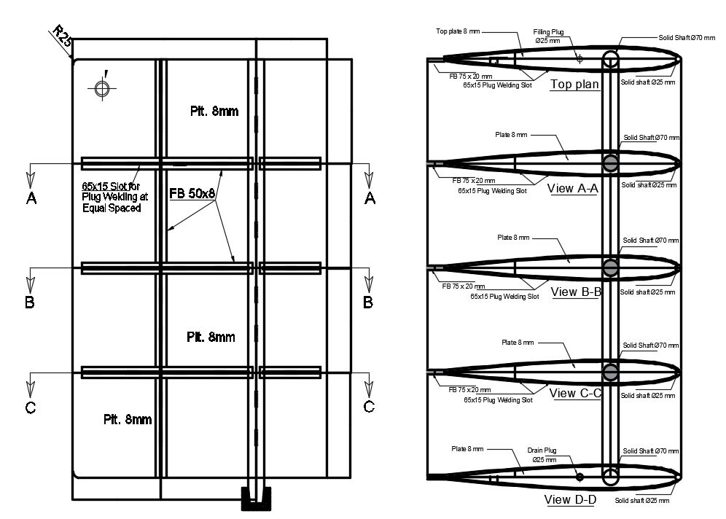
Rudder Design & Steering Arrangement (contd.)
Rudder Drawing

Slide 30
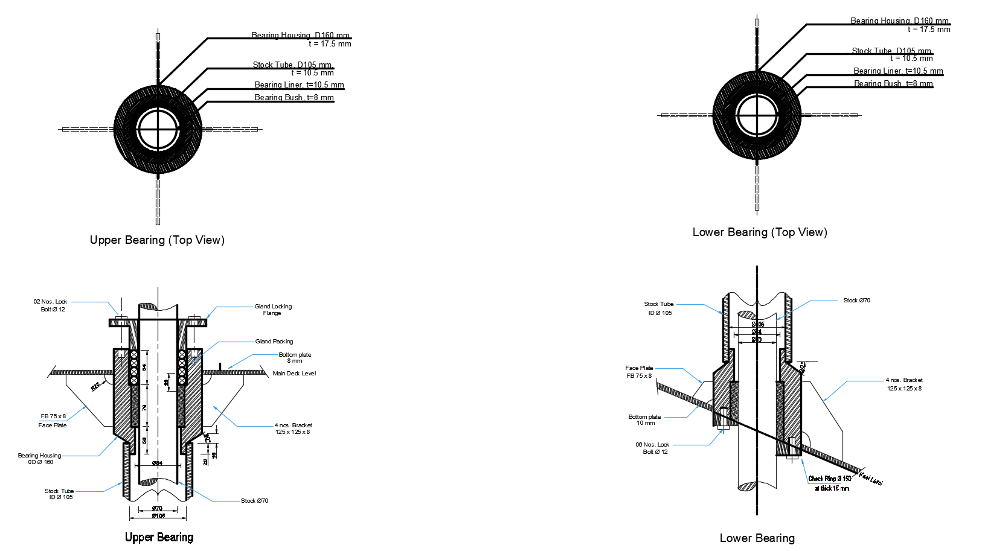
Rudder Design & Steering Arrangement (contd.)
Rudder Drawing

Slide 31
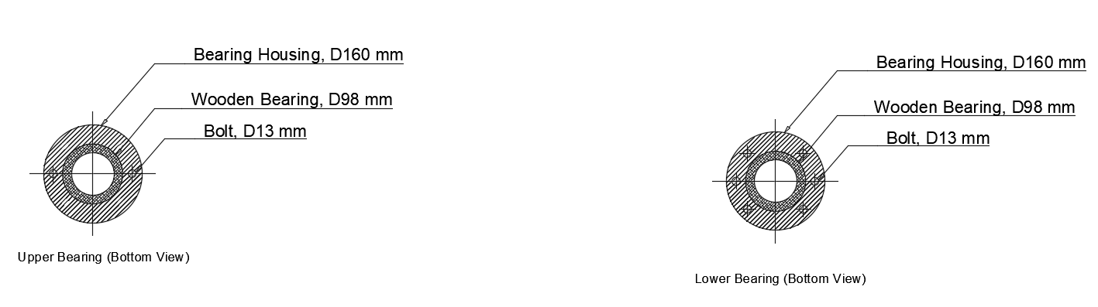
Rudder Design & Steering Arrangement (contd.)
Rudder Drawing

Slide 32
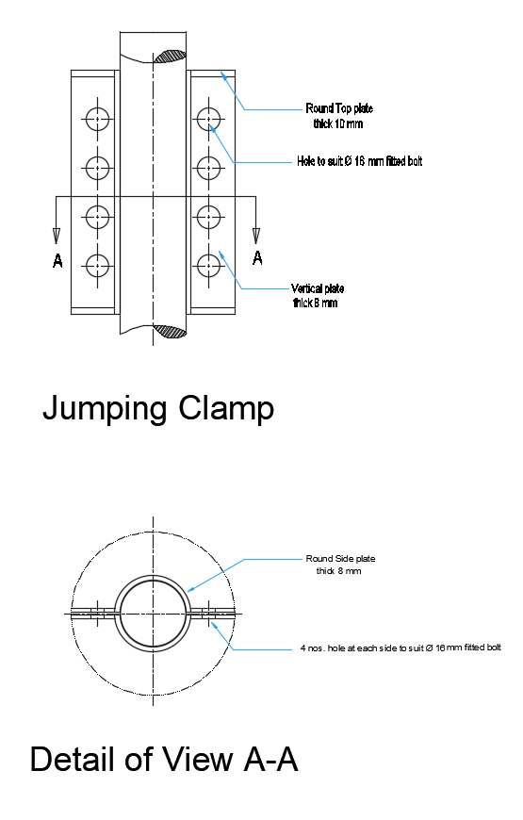
Rudder Design & Steering Arrangement (contd.)
Rudder Drawing

Slide 33
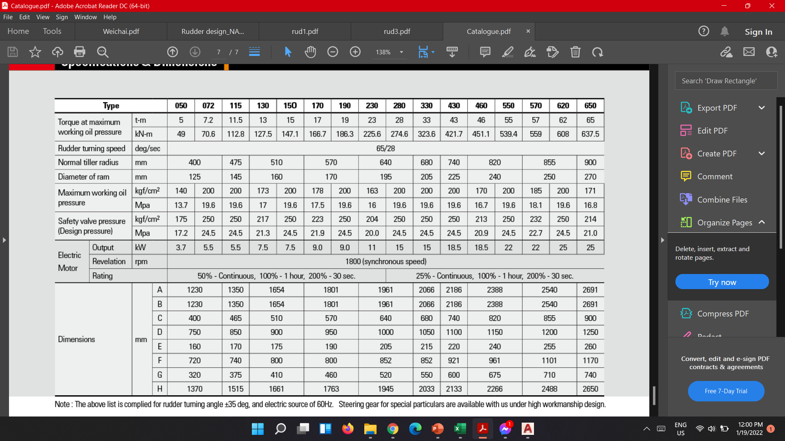
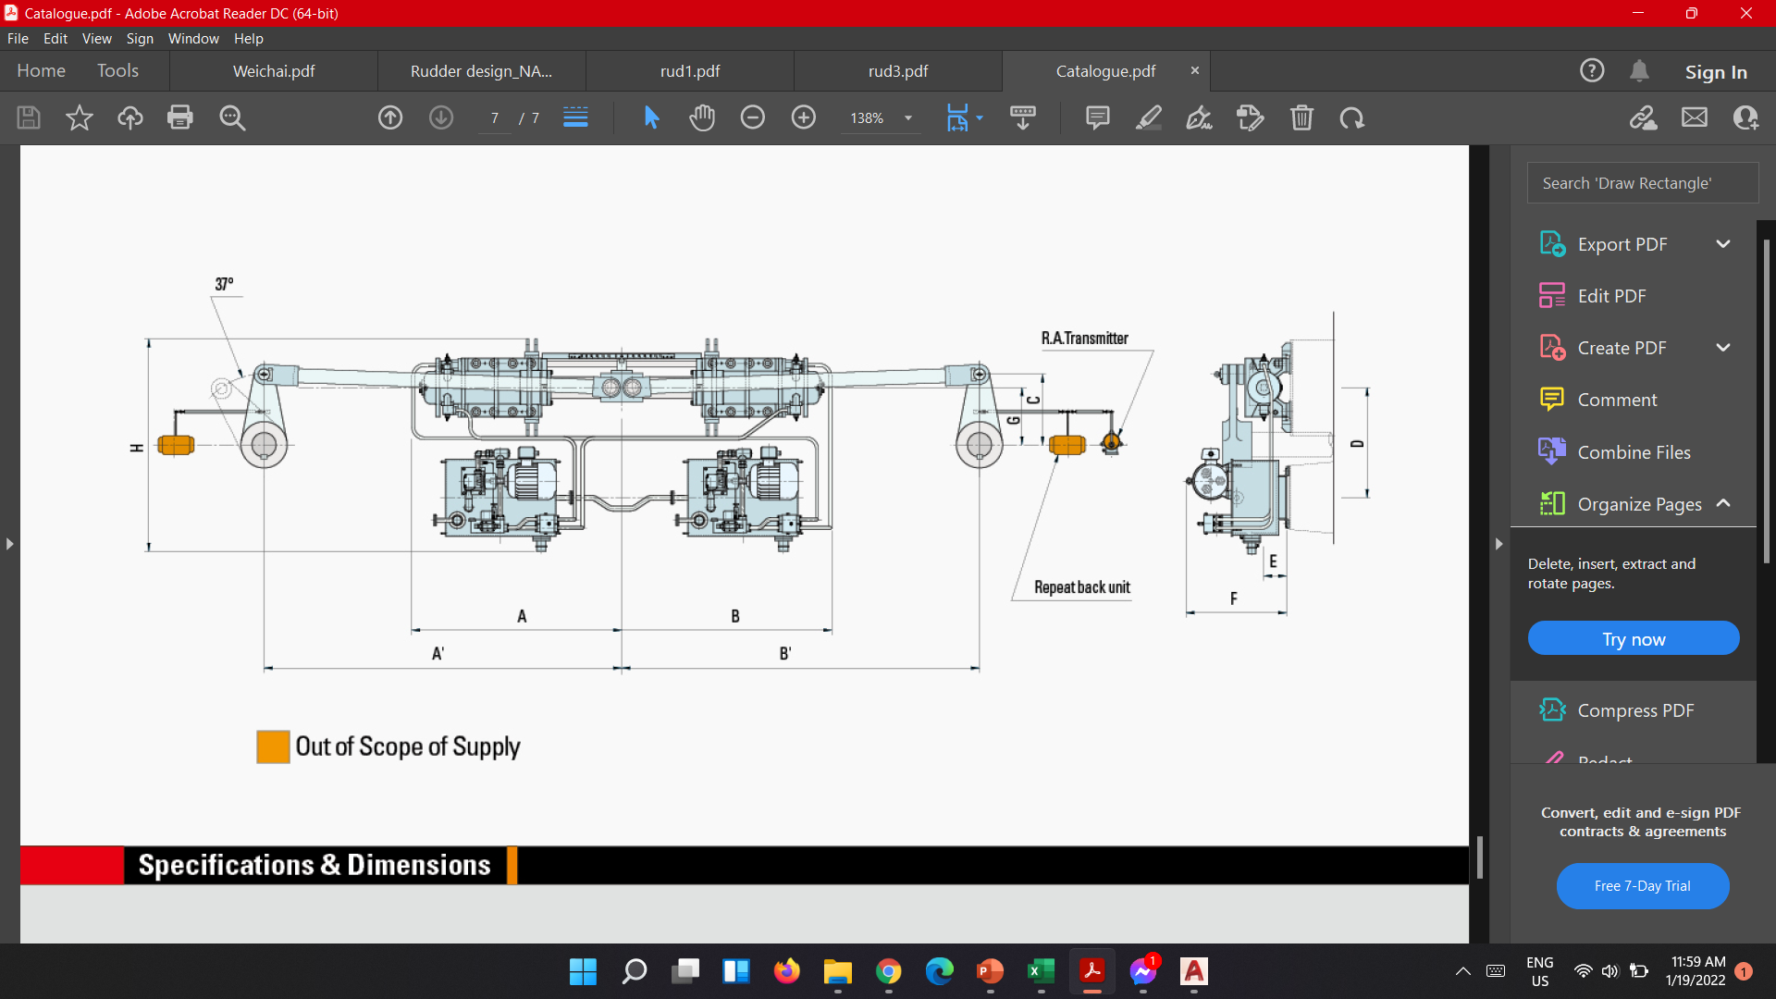
Rudder Design & Steering Arrangement (contd.)
Steering Gear

Slide 34
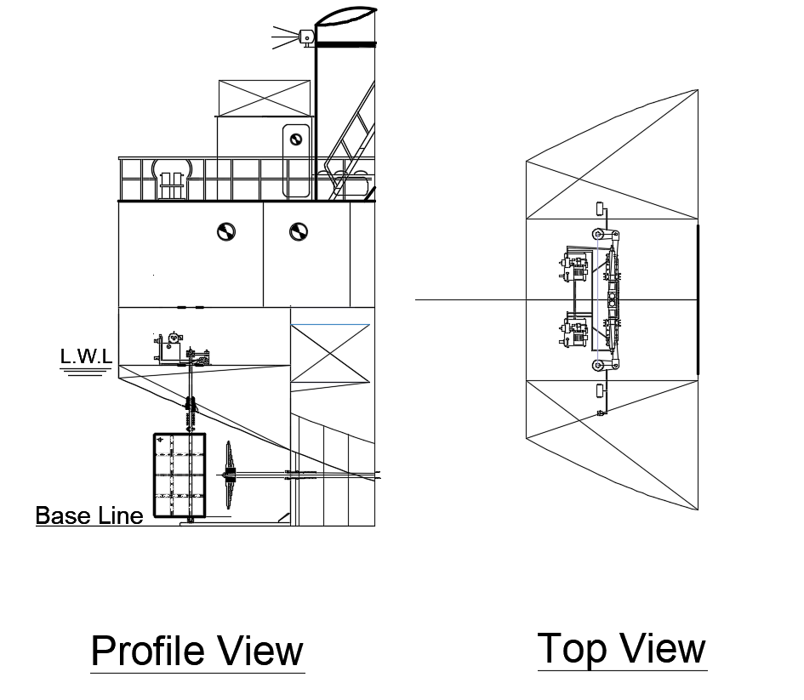
Rudder Design & Steering Arrangement (contd.)
Steering Gear

Slide 35
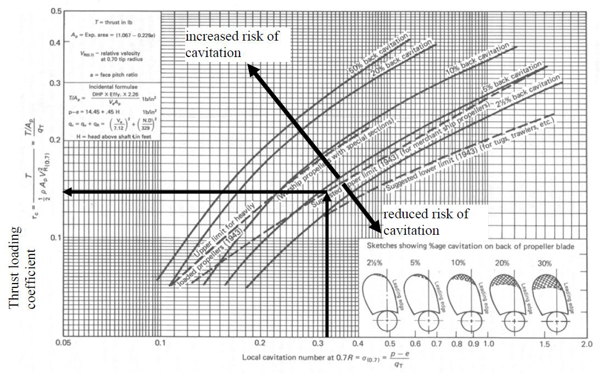
Propeller Design
Cavitation Check
BAR | 0.65
Open water efficiency | 0.55
P/D | 0.91
J | 0.51
Min. BAR (for cavitation) | 0.598

Slide 36
Propeller Design (contd.)
Propeller Parameters
Number of propellers | 2
Number of blades | 3
BAR | 0.65
Diameter, D | 1.533 | m
P/D | 0.91
Efficiency | 0.55
Propeller speed | 327 | rpm
Pitch, P | 1.395 | m

Slide 37
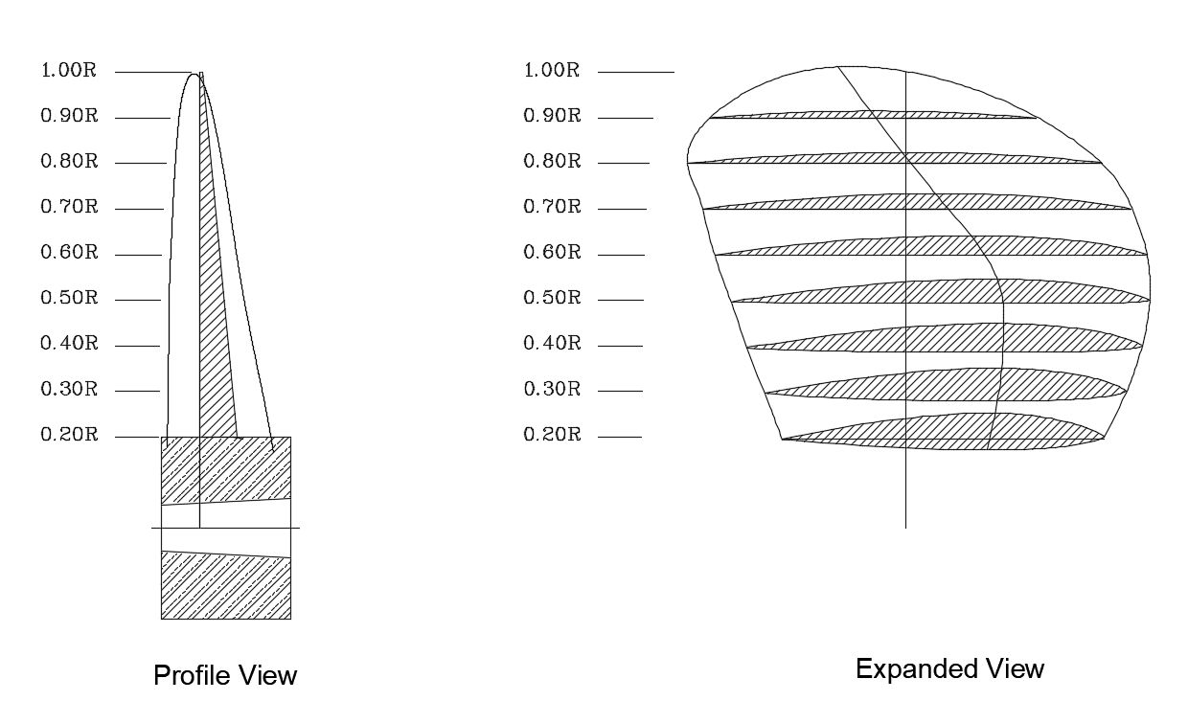
Propeller Design (contd.)
Propeller Drawing

Slide 38
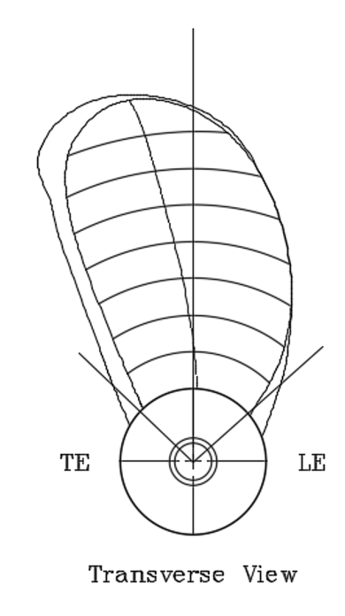
Propeller Design (contd.)
Propeller Drawing

Slide 39
Design of Engine Foundation
Scantling Summary (Engine Room) (DNV – GL 2016)
Plate Floor | 8 | mm
Longitudinal Girder | 8 | mm
Side Girder | 8 | mm
Inner Bottom Plate | 7 | mm
Top Plate (Thickness) | 23 | mm
Top Plate (Width) | 270 | mm
Bottom Plate | 10 | mm
Web Frame | T-200x100x12 | mm
Foundation Bolt (Diameter) | 3 | mm
Foundation Bolt (Spacing) | 70 | mm

Slide 40
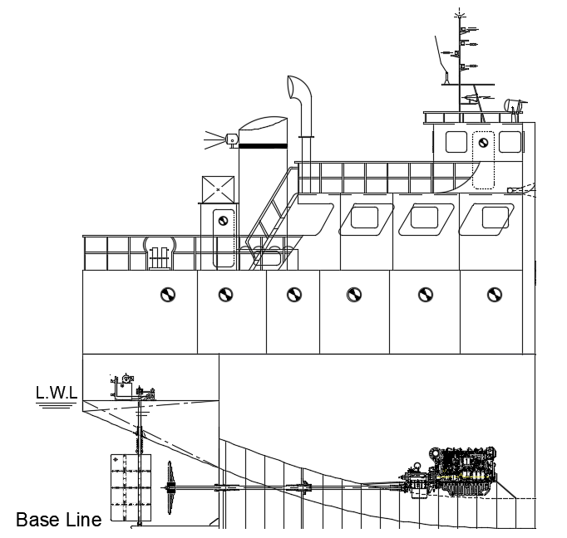
Design of Engine Foundation (contd.)
Profile View

Slide 41
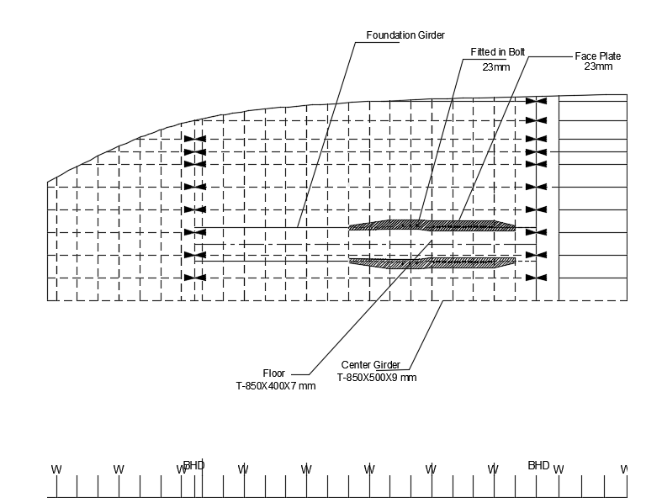
Design of Engine Foundation (contd.)
Plan View

Slide 42
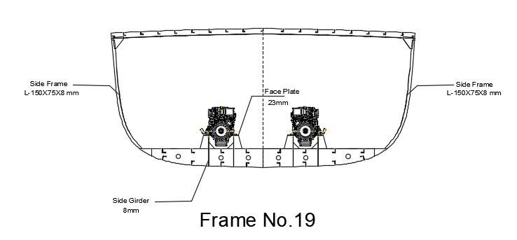
Design of Engine Foundation (contd.)

Slide 43
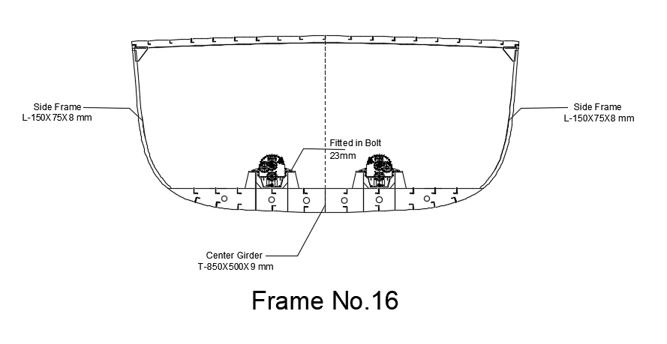
Design of Engine Foundation (contd.)

Slide 44
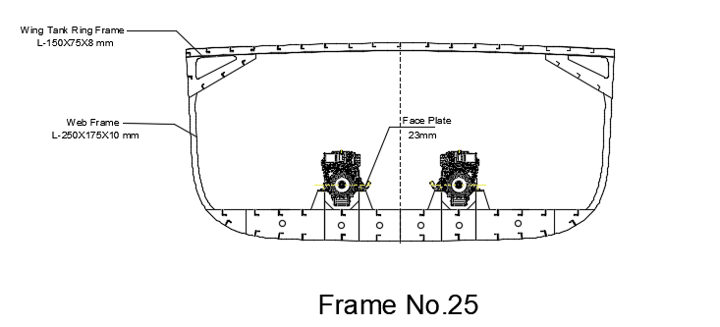
Design of Engine Foundation (contd.)

Slide 45
Shafting Arrangement Summary
Shaft Speed | 327 | rpm
Torque | 16 | kNm
Stress | 120 | Nm^-2
Shaft Diameter | 100 | mm
Twisting angle | 4.75 | degrees
Shaft liners | 6 | mm
Coupling | 18 | mm
Shaft bearing max. distance | 2.6 | m
Stern tube bearing (fwd.) | 90 | mm
Stern tube bearing (aft) | 220 | mm
Flange coupling bolt diameter | 38 | mm

Slide 46
Shafting Arrangement Summary (Contd.)
SL. NO | DESCRIPTION | MATERIALS | NUMBER OF COMPONENT
1 | Cone nut | M.B. BS | 1
2 | Cone nut securing screw | M.B. BS | 2
3 | Propeller key | M.B. BS | 1
4 | Propeller dia X pitch | M.B. BS | 1
5 | Aft Brg securing screw | M.B. BS | 3
6 | Cover plate securing screw | STEEL BS | 3
7 | Aft locking ring | STEEL BS | 1
8 | Cover plate | STEEL BS | 1
9 | Lock ring securing screw | STEEL BS | 3
10 | FWD locking ring | STEEL BS | 1
11 | Rubber bearing
12 | Sterntube | STEEL BS | 1
13 | Tailshaft |  | 1
14 | gland housing | G.M. BS | 1
15 | FWD bearing | G.M. BS | 1
16 | Greasy packing | GRAPHITED ASBESTOS | 3 turns
17 | Gland ring | G.M. BS | 1
18 | Gland studs and nuts | M.B. BS | 2
19 | Coupling key | STEEL BS | 1
20 | Half coupling | STEEL BS | 1
21 | Backing washer | STEEL BS | 1
22 | Locking nut | STEEL En7 BS | 1
23 | Sealing ring | BS | 1
24 | Fwd brg securing screw | M.B. BS | 1
25 | Bearing lock ring | STEEL BS | 1

Slide 47
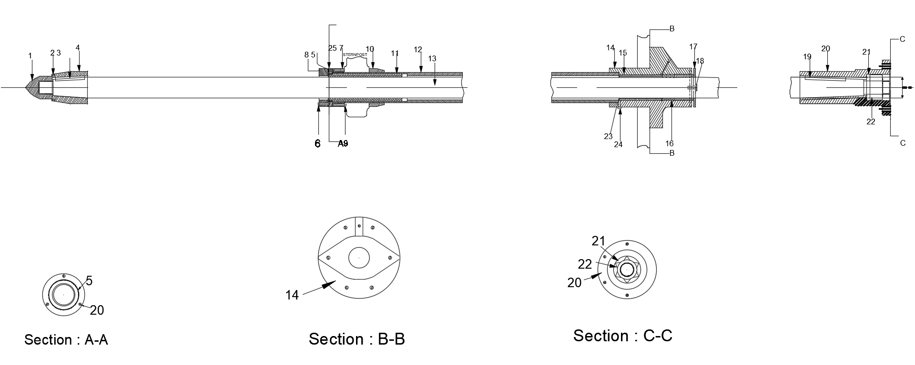
Shafting Arrangement Drawing

Slide 48
Detailed Weight Calculation
 | Item | Weight (tonnes) | LCG (m) | Moment (t-m) (about aft) | VCG (m) | Moment (t-m) (about keel)
1 | Steel Weight | 640.95 | 29.87 | 19143.08 | 2.40 | 1535.94
2 | Wood & Outfit Weight | 11.49 | 8.19 | 94.07 | 7.09 | 81.47
3 | Machinery Weight | 57.96 | 25.97 | 1505.37 | 3.86 | 223.48
Total Lightship Weight |  | 710.40 | 29.20 | 20742.52 | 2.59 | 1840.88

Slide 49
Detailed Weight Calculation (contd.)
Machinery Weight
 | Item | No. | Unit weight (tonnes) | Total weight (tonnes) | LCG (m) | Moment (about midship) | VCG (m) | Moment (about keel)
1 | Main Engine | 2 | 2.39 | 4.78 | 10.8 | 51.62 | 1.65 | 7.89
2 | Gear Box | 2 | 0.72 | 1.44 | 10.6 | 15.26 | 1.6 | 2.30
3 | Generator | 2 | 0.465 | 0.93 | 8.39 | 7.80 | 1.5 | 1.40
4 | Pump | 3 | 0.21 | 0.63 | 8.15 | 5.13 | 1.2 | 0.76
5 | Exhaust and Chimney | 1 | 1.25 | 1.25 | 8.17 | 10.21 | 6 | 7.50
6 | Engine Control Room Equipment | 1 | 3 | 3.00 | 8 | 24.00 | 7.31 | 21.93
7 | Rudder & Steering Arrangement | 2 | 1.96 | 3.92 | 1.62 | 6.35 | 3.63 | 14.23
8 | Anchor & Chain | 3 | 3.06 | 9.18 | 61.6 | 565.49 | 5.5 | 50.49
9 | Bollard, Capstan and other Fittings |  | 4 | 4.00 | 61.68 | 246.72 | 5.5 | 22.00
10 | Propeller, Propeller Shaft | 2 | 1.20 | 2.41 | 1.5 | 3.61 | 0.85 | 2.05
11 | Complete Electrical System |  | 3 | 3.00 | 7 | 21.00 | 5 | 15.00
12 | Hatch Coaming Girder |  | 3 | 3.00 | 34 | 102.00 | 4.5 | 13.50
13 | Complete Piping |  | 2 | 2.00 | 33.5 | 67.00 | 4.3 | 8.60
14 | Windlass | 1 | 1 | 1.00 | 32 | 32.00 | 4.3 | 4.30
15 | Mooring Rope |  |  | 1.00 | 62.5 | 62.50 | 5.7 | 5.70
 |  |  |  | 52.69 |  | 1158.21 |  | 171.94

Slide 50
Detailed Weight Calculation (contd.)
Machinery Weight (contd.)
Total Machinery Weight | 57.96 | tonnes
LCG (from aft) | 25.97 | m
VCG (from keel) | 3.86 | m

Slide 51
Detailed Weight Calculation (contd.)
Fully Loaded Departure Condition
No. | Item | Weight (tonnes) | LCG (m) | Moment (t-m) (about aft) | VCG (m) | Moment (t-m) (about keel)
1 | Light Ship | 710.40 | 29.20 | 20742.52 | 2.59 | 1840.88
2 | Crew (13) | 0.975 | 8.75 | 8.53 | 5.50 | 5.36
3 | Fuel Oil | 8.85 | 12.34 | 109.21 | 3.07 | 27.17
4 | Lub Oil | 0.07 | 4.60 | 0.32 | 3.00 | 0.21
7 | Fresh Water | 5 | 64.00 | 320.00 | 2.80 | 14.00
9 | Cargo Hold 1 | 450 | 52.67 | 23701.50 | 2.92 | 1314.00
10 | Cargo Hold 2 | 568 | 37.54 | 21322.72 | 2.92 | 1658.56
11 | Cargo Hold 3 | 568 | 21.13 | 12001.84 | 2.92 | 1658.56
Total Weight |  | 2311.30 | 33.84 | 78206.64 | 2.82 | 6518.74

Slide 52
Detailed Weight Calculation (contd.)
Fully Loaded Arrival Condition
No. | Item | Weight (tonnes) | LCG (m) | Moment (t-m) (about aft) | VCG (m) | Moment (t-m) (about keel)
1 | Light Ship | 710.40 | 29.20 | 20742.52 | 2.59 | 1840.88
2 | Crew (13) | 0.975 | 8.75 | 8.53 | 5.50 | 5.36
3 | Fuel Oil (10%) | 0.885 | 12.34 | 10.92 | 3.07 | 2.72
4 | Lub Oil (10%) | 0.007 | 4.60 | 0.03 | 3.00 | 0.02
7 | Fresh Water (10%) | 0.5 | 64.00 | 32.00 | 2.80 | 1.40
9 | Cargo Hold 1 | 450 | 52.67 | 23701.50 | 2.92 | 1314.00
10 | Cargo Hold 2 | 568 | 37.54 | 21322.72 | 2.92 | 1658.56
11 | Cargo Hold 3 | 568 | 21.13 | 12001.84 | 2.92 | 1658.56
Total Weight |  | 2298.77 | 33.85 | 77820.06 | 2.82 | 6481.50

Slide 53
Stability Calculations
Condition | Lightship Condition | Arrival Condition | Departure Condition
Angle | GZ(m) | GZ(m) | GZ(m)
0 | 0.000 | 0.000 | 0.000
15 | 0.532 | 0.335 | 0.500
30 | 1.541 | 0.569 | 0.898
45 | 2.313 | 0.703 | 0.974
60 | 2.536 | 0.669 | 0.712
75 | 1.594 | 0.328 | 0.381
90 | -0.248 | -0.040 | -0.060

Slide 54
Stability Calculations (contd.)
Lightship Condition

Slide 55
Stability Calculations (contd.)
Fully Loaded Departure Condition

Slide 56
Stability Calculations (contd.)
Fully Loaded Arrival Condition

Slide 57
Stability Calculations (contd.)
Properties | IMO value | Lightship Condition | Arrival Condition | Departure Condition | Comment
Area up to 30 degree (m-rad) | ≥ 0.055 | 0.3201 | 0.1665 | 0.2529 | Satisfied
Area up to 40˚ (m-rad) | ≥ 0.09 | 0.7450 | 0.3093 | 0.4740 | Satisfied
Area up to 30˚ - 40˚ (m-rad) | ≥ 0.03 | 0.4250 | 0.1428 | 0.2210 | Satisfied
GZ at 30 degree (m) | ≥ 0.2 | 1.5410 | 0.5693 | 0.8984 | Satisfied
Max. GZ at (degree) | ≥ 30 (preferable) but not ≤ 25 | 45 | 52 | 42 | Satisfied
Initial Metacentric Height (m) | Should not be ≤ 0.15 | 2.3 | 1.4 | 1.9 | Satisfied

Slide 58
Trim Calculations
Fully Loaded Departure Condition
Final Draft of Vessel
 | Draft (aft) | Draft (fore) | Comment
Mean Draft (m) | 3.65 | 3.65 | Trim by Stern
Change in Draft (m) | 0.05 | 0.05
Final Draft (m) | 3.70 | 3.60

Slide 59
Trim Calculations (contd.)
Fully Loaded Arrival Condition
Final Draft of Vessel
 | Draft (aft) | Draft (fore) | Comment
Mean Draft (m) | 3.65 | 3.65 | Trim by Stern
Change in Draft (m) | 0.16 | 0.17
Final Draft (m) | 3.81 | 3.48

Slide 60
Trim Calculations (contd.)
Lightship Condition
Final Draft of Vessel
 | Draft (aft) | Draft (fore) | Comment
Mean Draft (m) | 3.65 | 3.65 | Trim by Stern
Change in Draft (m) | 0.77 | 0.72
Final Draft (m) | 4.42 | 2.93

Slide 61
Thank You.

Slide 62
References
1. Germanischer Lloyd, 13th Edition (GL-13)
2. Illustration of Hull Structures (English/Japanese),
Dr. Hirohiko Emi (Author/Illustrator)
3. ISO-2001
4. DNV-GL 2016
5. Weichai Marine Engines Catalogue

